Slide 1

MATLAB with PYTHON NBA API
🏀
Notes:
My name is Yann, and in this video, I’ll show you how I’m using MATLAB with the NBA API in Python to analyze basketball data.

Slide 2
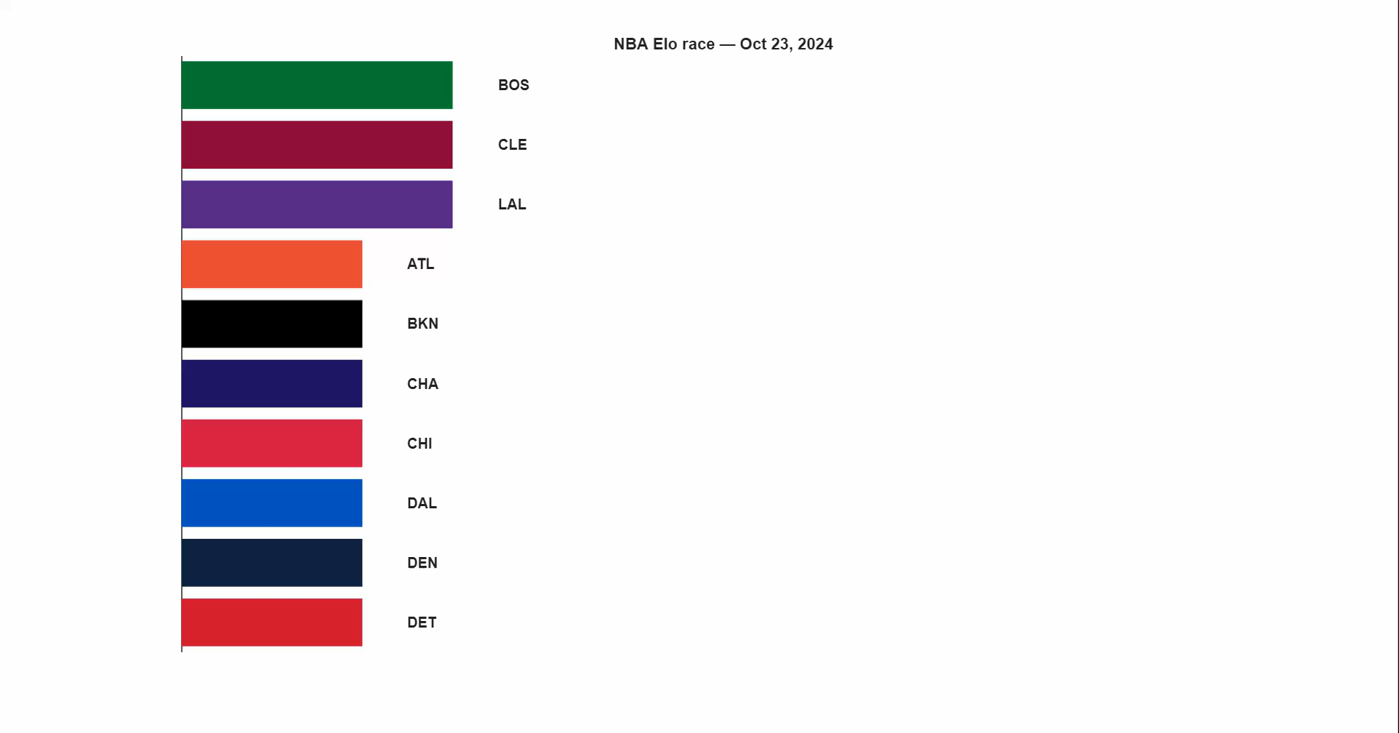

Slide 3

Dataset
📈
Find a dataset to analyze the NBA championship

Slide 4
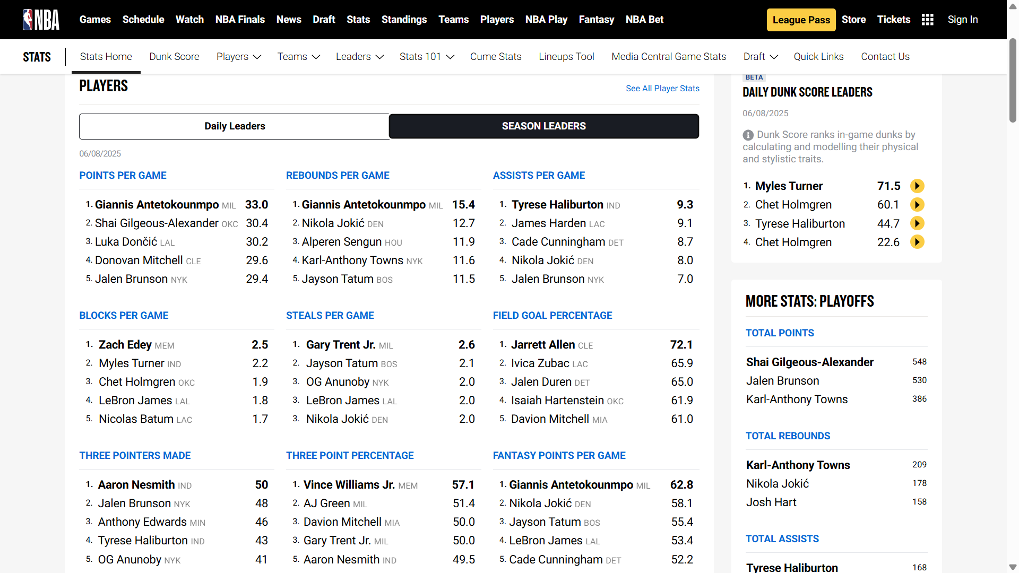

Slide 5
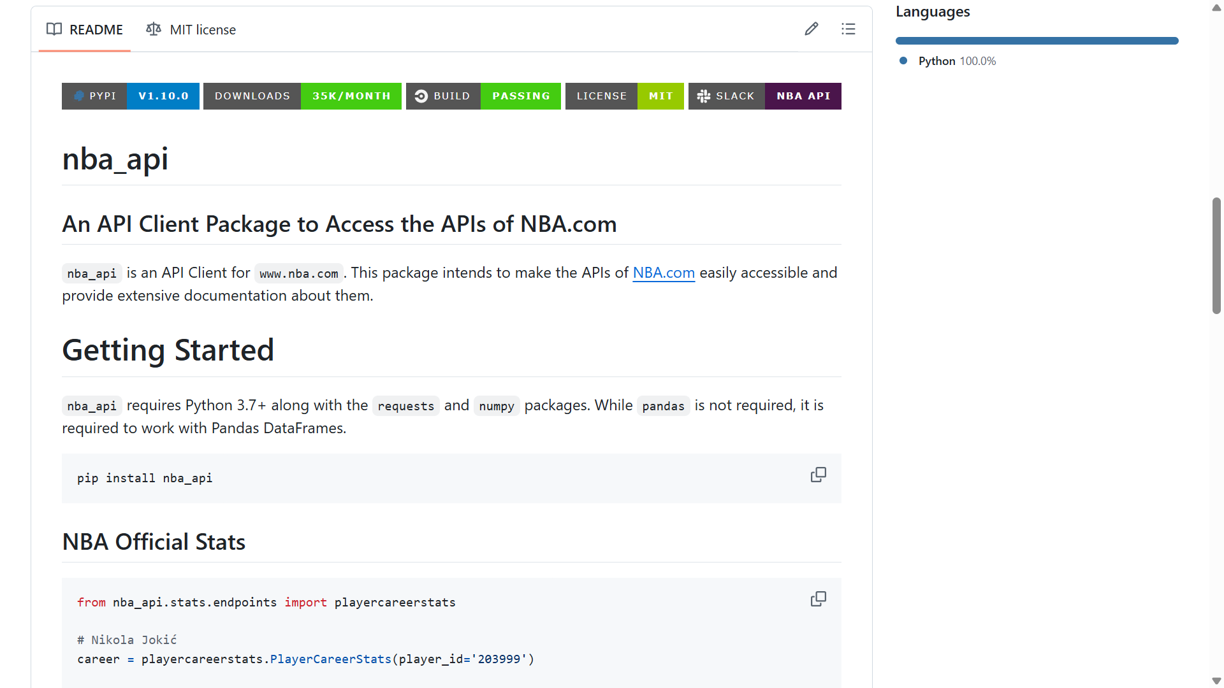

Slide 6
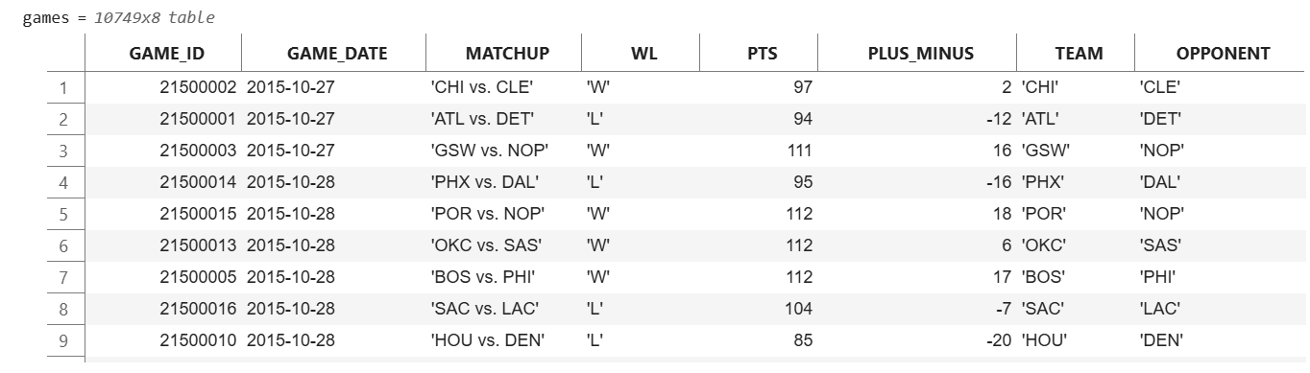
Dataset 📈

Slide 7
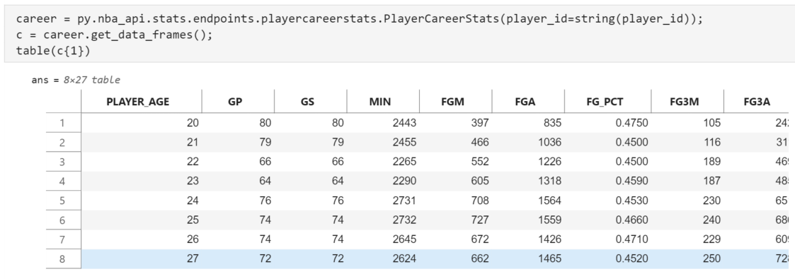
Players⛹️

Slide 8
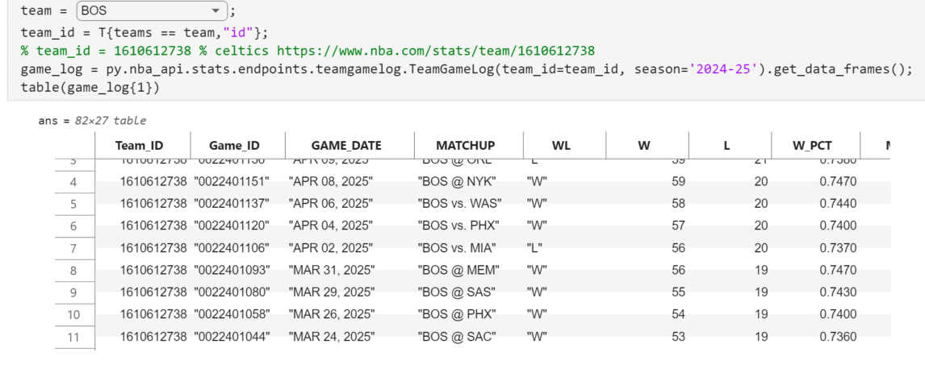
Teams👥

Slide 9
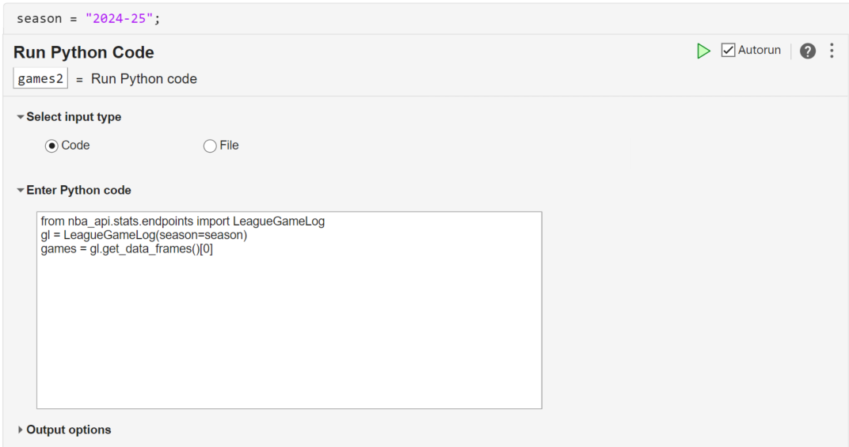
Games🏀

Slide 10

What are the odds?
🏆

Slide 11




1678
1595

Slide 12
1698
1575

Slide 13

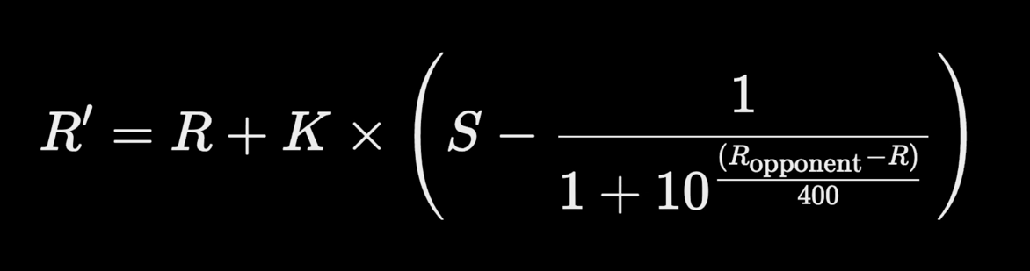
ELO Rating
Elo rating is a method for calculating the relative skill levels of players and teams in competitor-vs-competitor games like chess, and it has been adapted for many sports, including basketball.

Slide 14
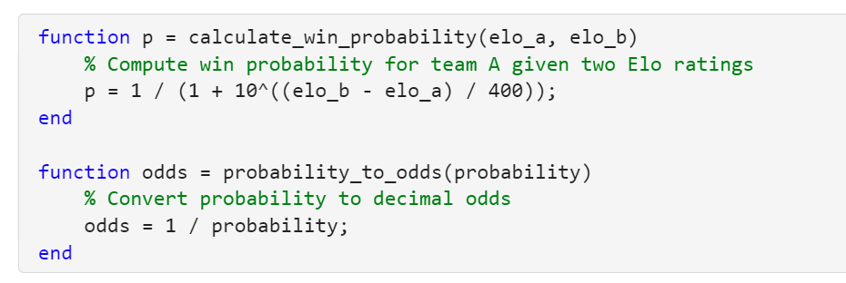
🎲 ELO Rank, Probabilities & Odds

Slide 15
Thanks for Watching
🏀

Slide 16
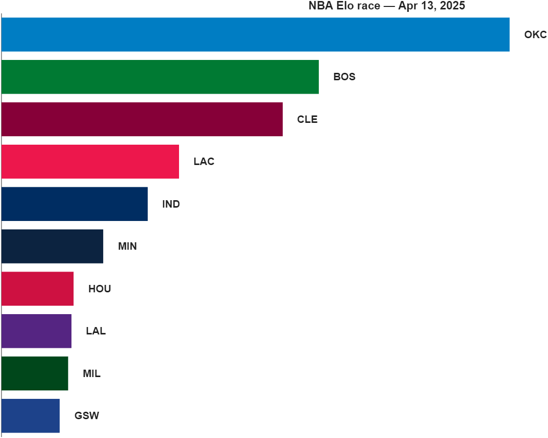

Slide 17
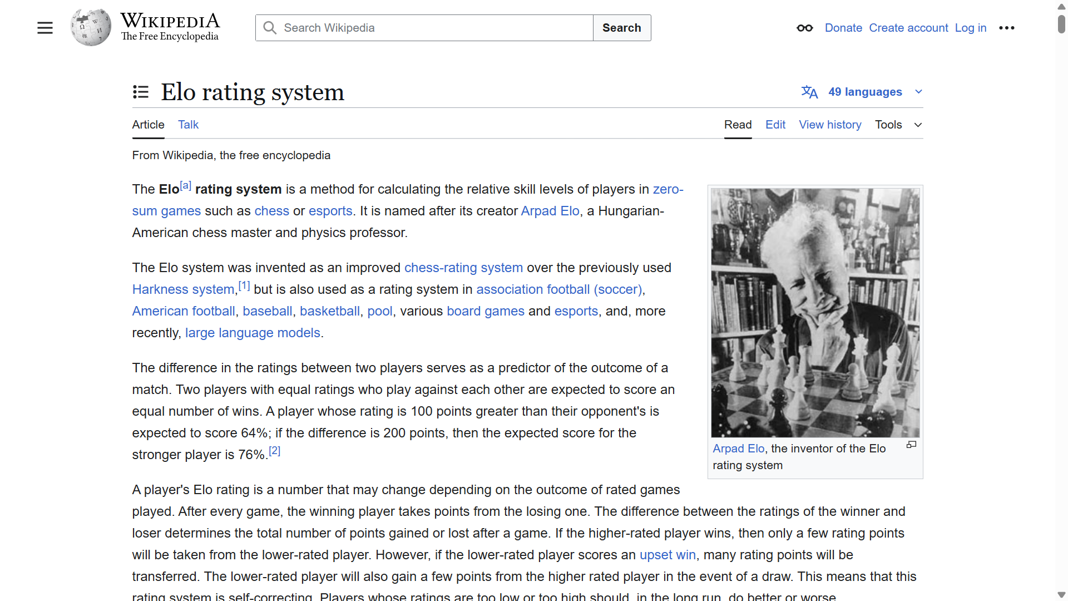
Notes:
https://en.wikipedia.org/wiki/Elo_rating_system

Slide 18
🔢 What is Elo Rating?
The Elo system updates a team’s rating based on the expected outcome of a match and the actual outcome. The key ideas:
Every team starts with a default rating (e.g., 1500).
A win increases your rating, and a loss decreases it.
Beating a highly rated team earns you more points than beating a lower-rated one.

Slide 19
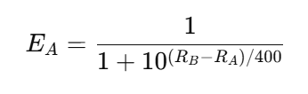
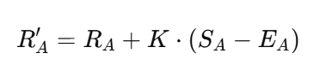
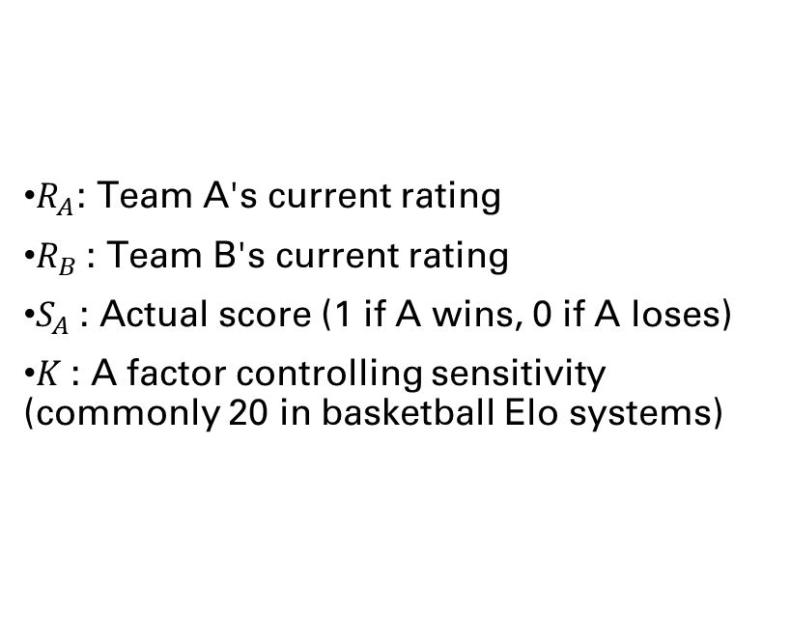
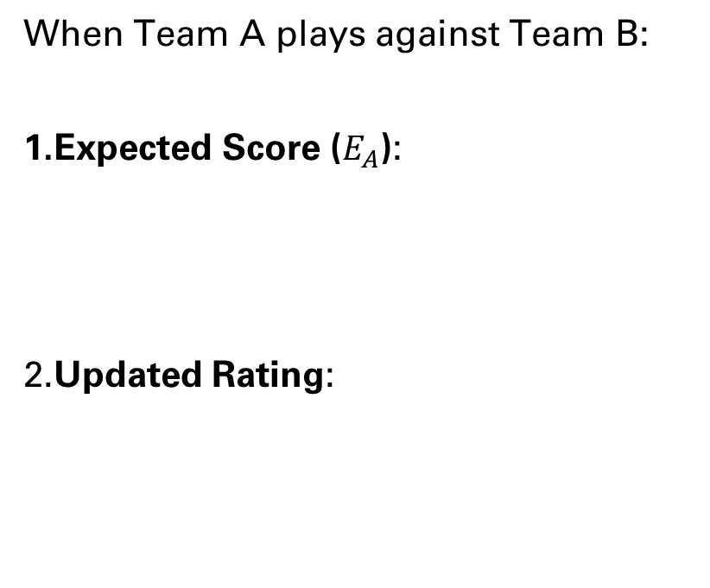
🧮 Elo Formula
When Team A plays against Team B:
Expected Score ($E_{A}$):
​Updated Rating:
​
$R_{A}$: Team A's current rating
$R_{B}$​: Team B's current rating
$S_{A}$​: Actual score (1 if A wins, 0 if A loses)
$K$: A factor controlling sensitivity (commonly 20 in basketball Elo systems)

Slide 20
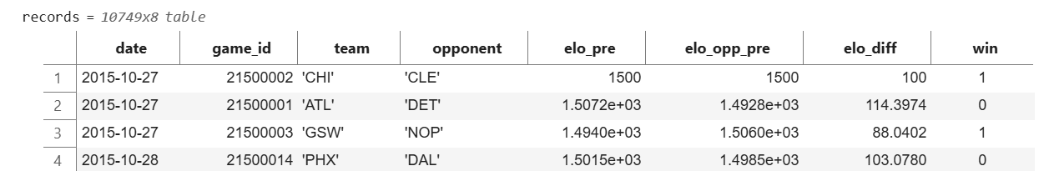
🏀 How Elo Is Applied to Basket
Sort the dataset by date
Initialize ratings (e.g., all teams start at 1500)
For each row:
Get ratings for winner_name and loser_name
Compute expected scores
Update both ratings based on the match outcome
📋 Example Dataset Columns

